Slide 1

Cancer Immune Therapy and Auto-inflammation in the Gut
Michael Dougan, MD, PhD
Director of the Immunotherapy Mucosal Toxicities Program
Massachusetts General Hospital
21 March 2018

Slide 2
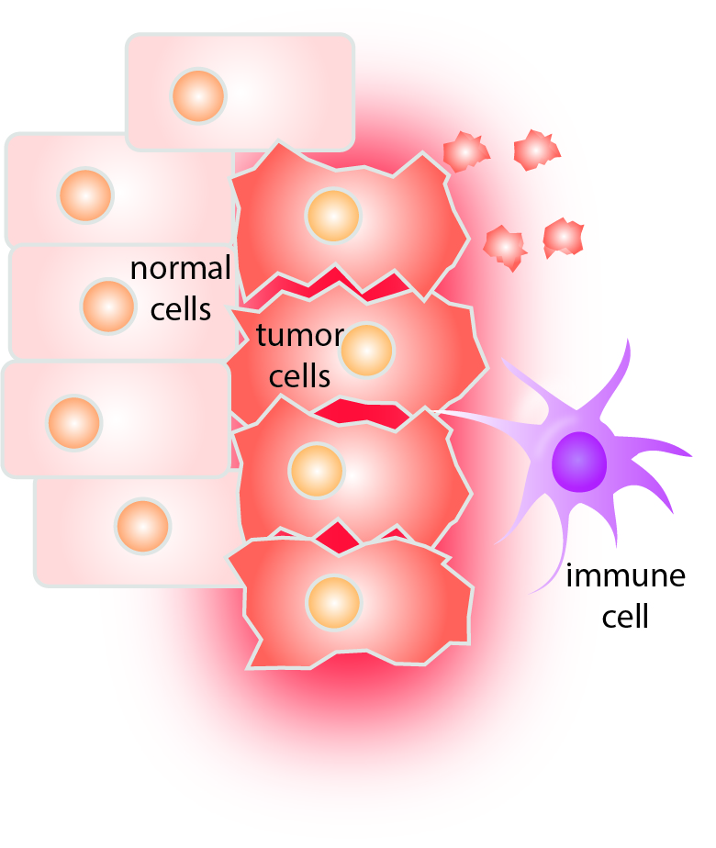
Cancer is like an infection that can’t be cleared
Mutations can be recognized
But the tumor defends itself using local immune suppression
Just like some viruses (Hepatitis C, Varicella, Human Papilloma Virus)

Slide 3
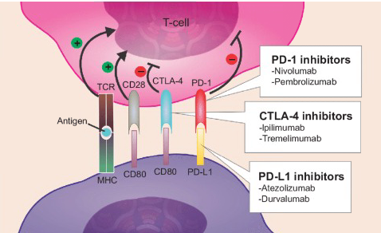
With help, the immune system can attack cancers

Slide 4
With help, the immune system can attack cancers

Slide 5
With help, the immune system can attack cancers

Slide 6
With help, the immune system can attack cancers

Slide 7
With help, the immune system can attack cancers

Slide 8
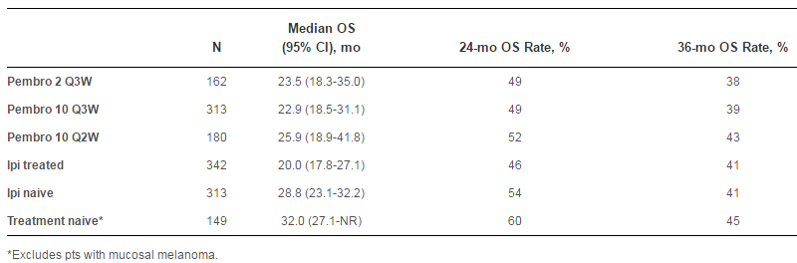
Immunotherapy has transformed cancer care
This number used to be < 5%
People with metastatic melanoma
Robert, JCO, 2016

Slide 9
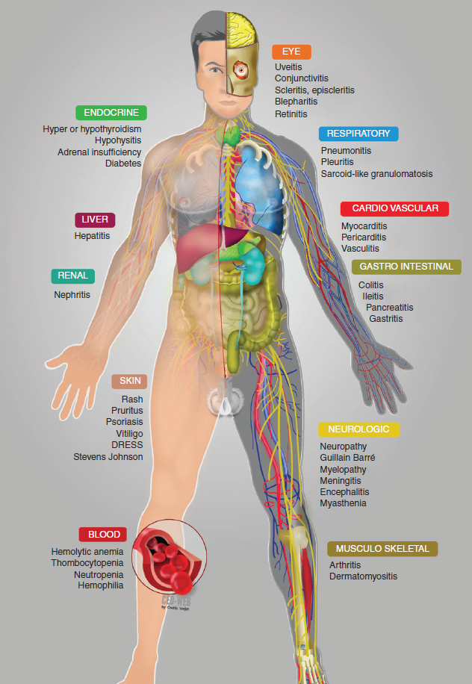
Altering immune regulation has consequences
People who receive immunotherapy can have inflammatory side effects in any organ
  Joints
  Skin
  Gut
  Fatigue
Called “immune-related adverse events”
These side effects can limit treatment opportunities, and often require immune suppression
Robert, JCO, 2016
Champiat, Ann of Onc, 2016

Slide 10
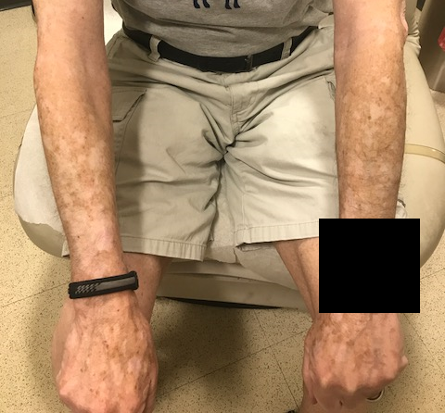
Immune-related adverse events are not just “side effects”
Vitiligo
Window into the biology of immune regulation

Slide 11
Immune-related adverse events are not just “side effects”
Vitiligo
Window into the biology of immune regulation
Potential insight into “spontaneous” autoimmune diseases
    We can learn things that animal models can’t teach us
This is an opportunity to look for new treatments

Slide 12
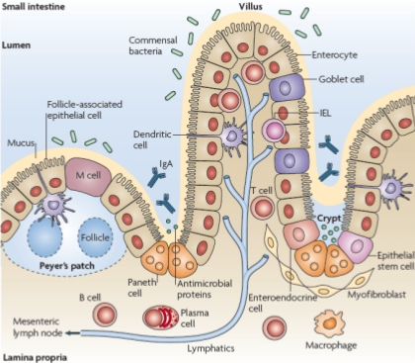
The gut is a very complex barrier
Careful immune regulation is essential to the gut
  Dietary antigens
  Commensal bacteria
  Pathogenic microorganisms
  Toxins
Abreu et al. Nat. Rev. Imm. 2010

Slide 13
Altering immune regulation leads to a wide-spectrum of common gut toxicities
Dougan M. Frontiers in Immunology. 2017.

Slide 14
Some immune-mediated diseases of the gut are not seen
Food allergies that cause anaphylaxis (like peanut allergies)
Eosinophilic esophagitis (an allergic disease of swallowing)
Does this tell us something about the role of CTLA-4 and PD-1/PD-L1 in the regulation of these diseases?

Slide 15
Immunotherapy induced colitis
Dougan M. Frontiers in Immunology. 2017.
Colitis

Slide 16
Immunotherapy induced colitis
Dougan M. Frontiers in Immunology. 2017.
Colitis

Slide 17
Immunotherapy induced colitis
Dougan M. Frontiers in Immunology. 2017.
By far the most common GI toxicity
  Up to 20% of patients on combination therapy have moderate-severe colitis
Range of severity
Likely responsible for most treatment related diarrhea
Colitis

Slide 18
Immunotherapy induced colitis is similar to inflammatory bowel disease (IBD)
Crohn’s Disease
Ulcerative Colitis
~1 million people in the United States have Inflammatory Bowel Disease
The cause is unknown, but the incidence is rising
~ evenly split between the two types of IBD
Treatment involves immune suppression

Slide 19
Immunotherapy induced colitis is similar to inflammatory bowel disease (IBD)
Crohn’s Disease
Ulcerative Colitis
Immunotherapy Induced Colitis

Slide 20
Immunotherapy induced colitis is similar to inflammatory bowel disease (IBD)
Crohn’s Disease
Ulcerative Colitis
Immunotherapy Induced Colitis
Acute inflammation across the colon
Ulcers, mucous, loss of colonic markings

Slide 21
Immunotherapy induced colitis is similar to inflammatory bowel disease (IBD)
Crohn’s Disease
Ulcerative Colitis
Immunotherapy Induced Colitis
Features more closely resemble ulcerative colitis
Continuous pattern, ulcers are shallow
Some aspects of Crohn’s are rare – strictures, abscesses, fistulas

Slide 22
Immunotherapy induced colitis is not the same as IBD
Dougan M. Frontiers in Immunology. 2017.
IBD is relapsing/remitting
For CTLA-4 blockade, the colitis is nearly always acute
PD-1/PD-L1 blockade can cause slowly progressive colitis
Maybe this tells us something about regulation by these receptors
Colitis

Slide 23
Upper abdominal disease is one of the “unique” features
Gastritis
Enteritis (small intestines)
Dougan M. Frontiers in Immunology. 2017.
Small intestinal inflammation is common (25% or more) with immunotherapy
For IBD, this is only seen in Crohn’s, and it rarely involves large regions
This might explain why patients with immunotherapy induced colitis get so much diarrhea

Slide 24
Is it safe to give immunotherapy to people with IBD?
6 patients with pre-existing IBD, all with very mild disease
2 cases of colitis (33%)
Higher than average risk (5-10%)
I have seen several of these patients and they tend to be more difficult to treat

Slide 25
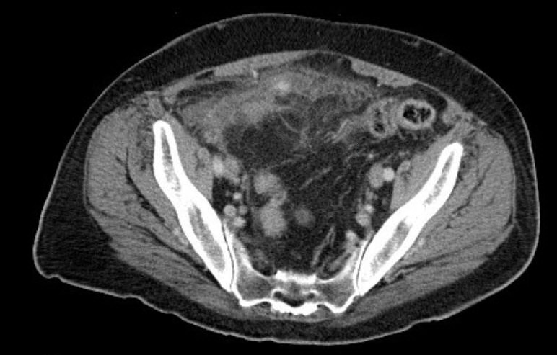
We do have to be cautious

Slide 26
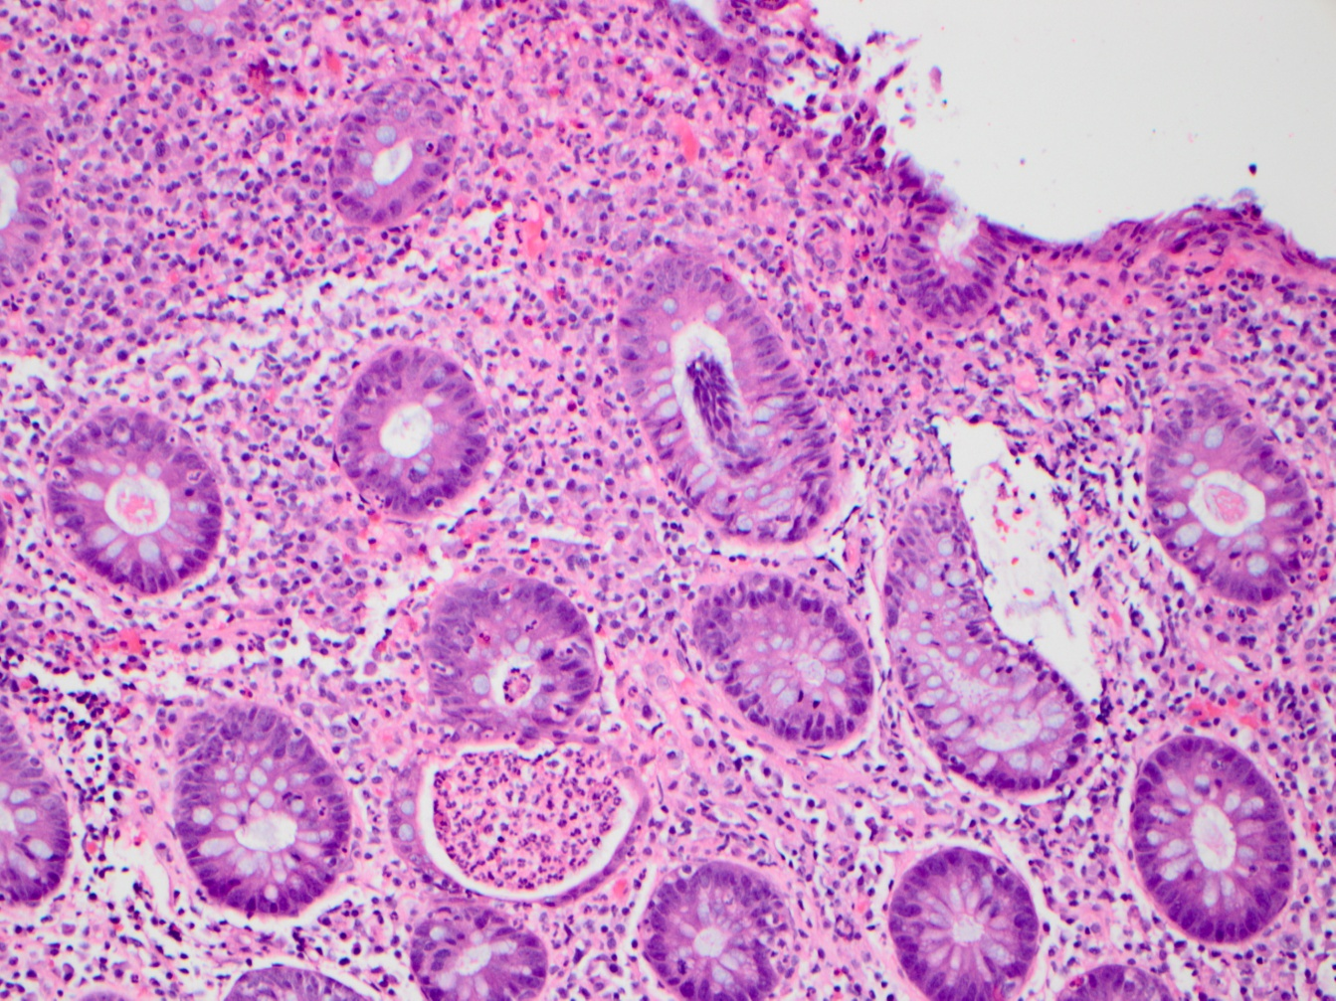
Histology of Typical Checkpoint Colitis
Lymphocytic and neutrophilic infiltrate
Prominent epithelial apoptosis

Slide 27
Histology of Typical Checkpoint Colitis
Lymphocytic and neutrophilic infiltrate
Prominent epithelial apoptosis
Crypt abscesses, rare granulomas reported
Preserved crypt architecture

Slide 28
How do we treat immunotherapy induced colitis?
Most people respond to several weeks of steroids
After resolution, this kind of colitis almost never comes back
  unless people are retreated
Sometimes steroids don’t work, then we use infliximab (Remicade)
We don’t know yet if other medications could be effective

Slide 29
Why does understanding these toxicities matter?
Solving the problem of immune toxicities will be important for expanding the reach of immunotherapy

Slide 30
Why does understanding these toxicities matter?
The implications are broader:

Slide 31
Why does understanding these toxicities matter?
The implications are broader:
Maybe these toxicities are the key to unlocking autoimmunity
Champiat, Ann of Onc, 2016

Slide 32
Why does understanding these toxicities matter?
Well defined autoimmune-like disease
The similarities to and differences from spontaneous disease teach us something about all people with autoimmunity
This could give us an opportunity to learn more about “causes”
Develop new treatments that target the first steps, rather than the consequences
Champiat, Ann of Onc, 2016

Slide 33



Acknowledgements
MGH Oncology
Ryan Sullivan Kerry Reynolds
Donald Lawrence Justine Cohen
Keith Flaherty Riley Fadden
Krista Rubin
MGH GI/Rheumatology
Alexandra-Chloe Villani
Ramnik Xavier
Molly Thomas
Dana-Farber Cancer Institute
Stephanie Dougan
Novartis
Glenn Dranoff

